Slide 1
EDDI DEMO Design Criteria – DDC Coordination and Development – CCFE (2016)
WPMAT
Deliverable ID: MAT-1.3.3-T003-D001 & D002
M. Kalsey, CCFE

Slide 2

MAT-1.3.3-T003-D001
Objective(s):
Specify the DDC task specifications
Coordinate DDC tasks
Hold regular DDC team progress meetings
Hold regular interface meetings with Blanket and Divertor teams
Attend Blanket, Divertor and Safety monitoring meetings
Deliverable(s):
Summary overview report on DDC coordination for 2016
Acceptance Criteria:
Deliverable(s) to be issued and approved through EUROfusion IDM

Slide 3
MAT-1.3.3-T003-D002
Objective(s):
Address received draft DDC comments.
Test the usability of the proposed elastoplastic design rules in using ANSYS.
Assess the possibility of making the DDC both ANSYS and ABAQUS compatible.
Complete the DDC and release issue 1.
Include case studies of both Blanket and Divertor.
Deliverable(s):
Summary overview report on DDC development for 2016
Acceptance Criteria:
Deliverable(s) to be issued and approved through EUROfusion IDM

Slide 4
MAT-1.3.3-T003
PRESENTATION CONTENTS
DDC COORDINATION
DDC DEVELOPMENT
CONCLUSIONS

Slide 5

DDC COORDINATION Introduction
The need for fusion specific structural design criteria is widely accepted as a must have to address specific needs of DEMO.
In response to this need, a package of work was initiated in 2012 by the EFDA Power Plant Physics & Technology (PPPT) organisation: DTM-03 DEMO Design Criteria
Objective:
Provide DEMO specific design criteria for Blankets and Diverters. This design criteria will provide the DEMO designers with a means to assess the structural integrity of all of the concept designs.

Slide 6
DDC COORDINATION Background
EDDI
Provide DEMO Divertor and Blanket design teams with design validation criteria.
Cover key damage mechanisms
Cover key modifying effects
Cover key joining techniques
Account for Structural and Armour elements
Provide appropriate level of conservatism
Provide clear unambiguous assessment rules
Align with modern FEA packages
Demo Design Criteria
Material Testing (Unirradiated)
Material Testing (Irradiated)
Material Database

Slide 7
DDC COORDINATION History
2012 DTM03 – Design Criteria Development.
Identification of DEMO Failure Modes.
Identification of Equivalent Failure Modes in ITER and Gen-IV.
Gaps in existing design codes for the design of DEMO components.
2013 DTM03 – Design Criteria Development.
Design code architecture for DEMO project
The assessment of R5 & R6 Procedures
Creep Fatigue Rules for EUROFER97
Structural Design Criteria for W/W alloys

Slide 8
DDC COORDINATION History
2014 EDDI 1.3 – DEMO Design Criteria.
Brittle Fracture Rule development
Creep Fatigue Rule development
Creep Fatigue assessment tool
Fatigue Rule development
Joint Rule Gap Analysis
2015 EDDI 1.3 – DEMO Design Criteria.
Brittle Fracture Rule development
Creep Fatigue Rule development
Ratcheting Rule development
Creep Fatigue assessment tool
Fatigue Rule development

Slide 9
DDC COORDINATION 2016 Summary
Coordination
DDC Coordination
DDC Development
DDC Industrial Review, Future developments, Classifications
1. Fill Priority Gaps
Brittle Fracture Rule development
Creep Fatigue Rule development
Armour and Joint Design Assessment
2. Improve
Technical Content
Fatigue initiation and crack propagation
Fatigue advanced modelling
Ratcheting rules
Plastic Flow Localisation Rule development
3. Improve use-ability
Creep Fatigue assessment tool
4. Educate the User
Divertor and Blanket Case Studies
Damage Mechanism Physical Examples
DDC Workshops
Slide 9

Slide 10
DDC COORDINATION Strategy
Following the Demo Design Criteria review meeting with F4E, SAF, DIV, BB, it was decided that a DDC strategy document is created to clearly define the following:
DDC Objectives aligned with the DEMO Roadmap Objectives and Timescales
DDC team structure
Define DDC Roles and Responsibilities, ensuring a limited overlap with BB, DIV, SAF and ITER
Define an interaction map between all interested parties (EDDI, BB, DIV, SAF, ITER, Industrial Partners, Regulators)
Define response to a number of combinations of Safety Classifications and Regulators.
Create an alignment between MPH & DDC, and then move forward together.
Can the DDC become an European standard (EN) or shall it eventually feed in to an existing Code
The draft of this report is expected to be completed by the end of Nov (not a deliverable). Strategy meeting to be held in early December.

Slide 11
DDC COORDINATION Team Structure (Under review)
Code Experts
Code Maker
AFCEN, ASME, SDC
Regulator
Industrial
AFW, AREVA?
Project Management
Technical Lead
DIV?
Technical Lead
BB?
DDC Coordinator
M Kalsey
Damage Mechanism
Experts
Plastic Collapse
N/A
Plastic Flow Localisation
tbd
Exhaustion Ductility
tbd
Armour Element
Jeong Ha
Brittle Fracture
Jarir Aktaa
Ratcheting
tbd
Fatigue
Mike Fursdon
Creep-Fatigue
Jarir Aktaa
Joint Element
Jason Hess
Material Experts
Design Allowable
?
Material Behaviour
?
EUROFER 97
Ermile Gaganidze
Tungsten
Ermile Gaganidze
CuCrZr
Chris Hardie

Slide 12
DDC COORDINATION DEMO Interactions
In order to increase awareness and interaction from within the DEMO project a number of activities were carried out:
EDDI Workshop
Well attended including members of DIV and BB teams.
DDC overview presentation delivered.
Creep Fatigue tool delivered with training.
Ratcheting rule delivered with training.
Regular DDC technical meetings held.
Fixed fortnightly meetings at CCFE.
Additional review meetings as and when issues arise.
Number of meetings held with CEA remotely and face to face.
Update meeting held with KIT (MG).
Fortnightly review meeting with AMECFW.
Attend DIV, SAF and BB meetings.
Attended all three meetings (remotely) at the start of 2016.
Attendance planned for DIV meeting in Nov.
Occasional one to one meeting held with Neil Tailor (SAF PL) to discuss progress.

Slide 13
DDC COORDINATION External Interactions
In order to increase awareness and interaction from outside of the DEMO projects a number of outreach activities were carried out:
Presented Fusion Design Code activities at Manchester University CDT event.
Invited back for future events.
Should improve interaction with DDC related PHD’s.
Created a number of potential contacts with the ONR.
Presented Fusion Design Code activities at the World Nuclear Association Design Codes and Standards Task Force meeting.
Provided insight into the WNA Non-Linear analysis review.
Expert contacts gained from the Fission industry.
Shall be invited to future meetings.
Attended the ASME Div 4 working group meeting.
International participation increasing with a strong European involvement.
Gain insight into future Code developments
IAEA Fusion Code harmonisation activities ongoing.
Safety Classification report underway.
Next meeting 9th Nov, update due after that.

Slide 14
DDC COORDINATION External – WNA Non-Linear
In 2007 the World Nuclear Association set up a Mechanical Codes and Standards Task Force. Created to promote convergence in two areas:
Non Destructive Examination
Non-Linear Analysis Methodology
Technical Coordinator
Claude Faidy | CORDEL Consultant | France
Project Coordinator
Andrew Wasylyk | WNA CORDEL | UK
Main Contributors
Claude Faidy | AFCEN | France
Seiji Asada | JSME/MHI-Japan | Japan
Andrey Obushev | ENES/NIKIET | Russia
Karl Herter | KTA/MPA | Germany
Robert Ainsworth | R5/Manchester University | UK
Hoon-Seok Byun | KEPIC | Korea
Reviewers
Robert Keating | ASME Code - Working Group Design Methodology | USA
Wolf Reinhart | ASME Code - Working Group Design Methodology | Canada
Jinhua Shi | AMEC Nuclear-UK | UK
Cecile Petesch | RCC-MRx Sub-Committee | France
Denis Pont | EDF-SEPTEN | France

Slide 15
DDC COORDINATION External – WNA Non-Linear
 | Plastic collapse |  |  |  | Plastic instability |  |  |  | Stress triaxiality
 | Limit Analysis |  | Direct elastic-plastic FEA |  | Limit Analysis |  | Direct elastic-plastic FEA |  | Direct elastic-plastic FEA
 | Material properties | Criteria | Material properties | Criteria | Material properties | Criteria | Material properties | Criteria | Material properties | Criteria
RCCM | Y | Y | N | N | N | N | N | N | N | N
ASME III | Y | Y | N | N | Y | Y | N | N | N | N
JSME | Y | Y | N | N | N | N | N | N | N | N
RCC-MRx | Y | Y | Y | Y | Y | Y | Y | P | N | N
KEPIC | Y | Y | N | N | Y | Y | N | N | N | N
PNAEG | N | N | N | N | N | N | N | N | N | N
KTA | N | N | N | N | N | N | N | N | N | N
R5 | Y | Y | N | N | N | N | N | N | N | N
ASME VIII | Y | Y | Y | Y | Y | Y | P | Y | P | Y
EN 13445 | Y | Y | N | N | N | N | N | N | N | N

Slide 16
DDC COORDINATION External – WNA Non-Linear
The DDC project should use this gap analysis as a starting point and assess additional damage mechanisms.
 | Plastic shakedown |  |  |  | Fatigue K_{e}
 | Direct elastic-plastic analysis - FEA |  |  |  | Direct elastic-plastic analysis - FEA
 | Material properties | Material constitutive equation | Criteria | Extrapolation rules | Material properties | Material constitutive equation | Method
RCCM | N | N | N | N | N | N | N
ASME III | N | N | N | N | N | N | N
JSME | Y | P | Y | N | Y | N | Y
RCC-MRx | P | P | N | Y | Y | P | N
KEPIC | N | N | N | N | N | N | N
PNAEG | N | N | N | N | Y | Y | Y
KTA | N | N | N | N | N | N | N
R5 | N | N | Y | N | N | N | N
ASME VIII | Y | N | Y | N | Y | N | Y
EN 13445 | N | N | N | N | N | N | N

Slide 17
DDC DEVELOPMENT Structure
Part 1: General Information: providing required background information, including definitions, load classifications, operating conditions, damage mechanism descriptions and design assessment philosophy.
Part 2: Design Assessment: providing required operating conditions, criteria levels, PFC element assessment and design rules.
Part 3: Material Data: the required physical property data along with the associated design allowable.
Part 4: Example Calculations: design assessment of a DEMO PFC is presented, demonstrating how an assessment should be carried out using ANSYS.
Part 5: Rule Justifications: explanations provided for why new or modified rules are adopted in the DDC.

Slide 18
DDC DEVELOPMENT Structure Part 1
Table of Contents
1 Introduction
2 Definitions and Abbreviations
3 Loading and Stress Classifications
4 Operating Conditions
5 Damage Mechanism Descriptions
6 Design Assessment Philosophy

Slide 19
DDC DEVELOPMENT Structure Part 2
Table of Contents
1 Introduction
2 Loads and Operating Conditions
3 Criteria Levels
4 PFC Element Assessment
5 Design Rules

Slide 20
DDC DEVELOPMENT Structure Part 3
Table of Contents
1 Introduction
2 CuCrZr
3 Eurofer
4 Tungsten

Slide 21
DDC DEVELOPMENT Structure Part 4
Table of Contents
1 Introduction
2 Divertor DDC Assessment
3 Blanket DDC Assessment

Slide 22
DDC DEVELOPMENT Structure Part 5
Table of Contents
1 Introduction
2 Design Philosophy
3 Load Factors
4 Design Rules

Slide 23
DDC DEVELOPMENT Structure Status
DDC Structure is ready to be reviewed. The following schedule is required to be met to ensure a successful delivery of Grant Deliverable.
DDC | Draft v1 | Reviewed | Updated | Released
Part 1 | Structure complete | 30th November | 31st December | 31st December
Part 2 | Structure complete | 30th November | 31st December | 31st December
Part 3 | Structure complete | 30th November | 31st December | 31st December
Part 4 | Structure complete | 30th November | 31st December | 31st December
Part 5 | Structure complete | 30th November | 31st December | 31st December

Slide 24
DDC DEVELOPMENT DDC Review Participants
The following people have been provisionally put in place to review the DDC structure, this will need to be done by Nov 30th to allow for changes to be made during December.
DDC Aspect | EDDI | DIV | BB | IND
Philosophy | Mike Fursdon Jarir Aktaa |  |  | AMECFW
Structure (30TH November) | Mike Fursdon Jarir Aktaa | Jeong Ha | Giacomo Aiello | AMECFW
Content | Mike Fursdon Jarir Aktaa | Jeong Ha | Giacomo Aiello | AMECFW
Design Rules | Mike Fursdon Jarir Aktaa

Slide 25
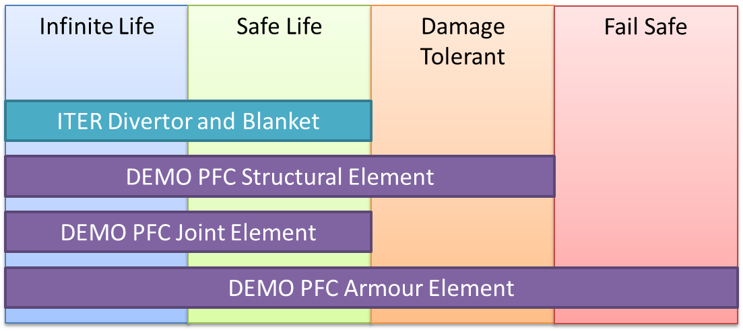
DDC DEVELOPMENT Philosophy
DDC Philosophy may be modified, depending upon findings from the Armour and Joint assessment work packages.

Slide 26
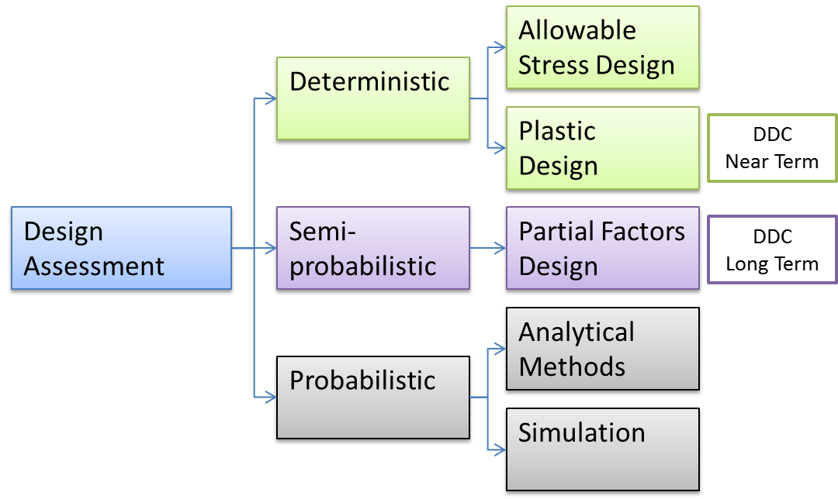
DDC DEVELOPMENT Philosophy
DDC Assessment Philosophy remains unchanged. However it is recommended that fully probabilistic methods are explored

Slide 27
DDC DEVELOPMENT PFC Assessment
The following damage mechanisms are provisionally defined for all 3 PFC elements. However this is subject to change following a review of Armour and Joint assessment reports.
Damage Mechanisms | Structural Element | Armour Element | Joint Element
Monotonic Damage
Plastic Collapse |  | Potentially relevant | n/a
Plastic Flow Localisation |  | Potentially relevant | n/a
Exhaustion of Ductility |  | Potentially relevant | n/a
Brittle Fracture |  |  | Potentially relevant
Thermal Creep |  | Potentially relevant | n/a
Cyclic Damage
Ratcheting |  | n/a | Potentially relevant
Fatigue
Environmental Damage
Swelling |  | n/a | Potentially relevant
Corrosion |  | n/a | Potentially relevant
Erosion |  |  | Potentially relevant
Compound Damage
Stress Corrosion Cracking |  | n/a | Potentially relevant
Creep Fatigue |  | Potentially relevant | n/a

Slide 28
DDC DEVELOPMENT Design Rule Status
Damage Mechanisms | From existing C&S, rewritten. | From existing C&S, with technical modifications. | Newly developed
Monotonic Damage
Plastic Collapse | ASME VIII rule identified, needs load factors and review.
Plastic Flow Localisation |  | Drafted, Under development
Exhaustion of Ductility |  | Drafted, Under development
Brittle Fracture | Drafted, needs to be reviewed by DME
Thermal Creep | Drafted, needs to be reviewed by DME.
Cyclic Damage
Ratcheting |  |  | Under Development
Fatigue |  | Under Development, needs to be drafted by DME | Under Development
Environmental Damage
Swelling
Corrosion
Erosion
Compound Damage
Stress Corrosion Cracking
Creep Fatigue |  | Under Development, needs to be drafted by DME

Slide 29
DDC DEVELOPMENT Advanced Structural Integrity
DDC is an opportunity to push the boundaries of Structural Integrity assessment techniques, particularly in areas where a potential increase in design space can be demonstrated.
Partial Factors
Review underway by AMECFW
It is likely that the DDC shall work towards including partial factors
System Based Code
ASME developing technique called RIM (Reliability and Integrity Management)
This technique should be reviewed to determine it’s applicability to the DDC
Advanced Material Modelling
Area of potential advancement in coming years?
Ability to model irradiation damage?

Slide 30
Conclusions
Draft DDC Structure has been created and is ready for a structured review.
Content is partially populated, however a large amount still remains to be completed, this shall continue in 2017.
Design rule development ongoing for a number of damage mechanisms, this shall feed into the DDC when ready.
The review of more advanced Structural Integrity assessment techniques is underway.
DDC Strategy review underway, this shall critically assess current performance and define a way forward.

Slide 31
Recommendations
Increased interactions required within the DEMO project.
Both the DDC and the MPH should be aligned to interact smoothly.
More experts should be involved in defining DDC direction and activities.
The ASME RIM assessment technique should be reviewed to determine applicability to DDC.
The DDC team should start to consider how to handle varying material data (over lifetime & geometrically).
Review all 2016 DDC reports to ensure findings are captured in the DDC
The DDC strategy should address highlighted issues, and maybe include MPH activities (EDDI Strategy).

Slide 32
Review: Objectives-Status for the 5 year period
5 year Objective(s):
Provide DEMO specific design criteria for Blankets and Diverters. This design criteria will provide the DEMO designers with a means to assess the structural integrity of all of the concept designs.
Achievement and status:
Report the achievements
DDC objective and strategy created, providing structured direction.
Team of experts bought together from RU’s.
Sought to break away from conventional C&S and adopt more advanced techniques
Damage mechanism development focused on Non-Linear rules.
Industrial involvement initiated.
Report (potential) failures
The creation of the DDC is taking longer than originally envisaged, and hence the original strategy needs to be revisited and improved.
The integration of work with DIV and BB teams needs to be better.
DDC work and activities was not publicised to the wider DEMO team.

Slide 33
Review: Objectives-Status for the 5 year period
Outlook:
Experienced DDC team is in place and growing.
In a good position to start bringing in new design rules into the documentation.
External Code developer network growing.
DDC structure needs to be reviewed, modified and released.
DDC content needs to be populated by relevant damage mechanism experts.
DDC strategy being developed.

Slide 34
THANK YOU

Slide 35























